Slide 1

LaunchCode Liftoff
Class 6
Hank DeDona
05/11/2020

Slide 2

Agenda
Lecture - Interview
Assignment - Interview Prep
Q&A
Activity
Scrum
Paired Interview Practice
Open Work Time

Slide 3
Liftoff Project Timeline
Address Feedback
Next Features
Behavioral Interviews
Class 5
Class 7
Class 6
Class 8
Next Features
Final Review
Notes:
Resume Aug 21st

Slide 4

Announcements
Last Class
June 8th
Assignments Due
Before June 8th

Slide 5
The Interview

Slide 6

2004 Comedy Featuring Seth Rogan and James Franco

Slide 7
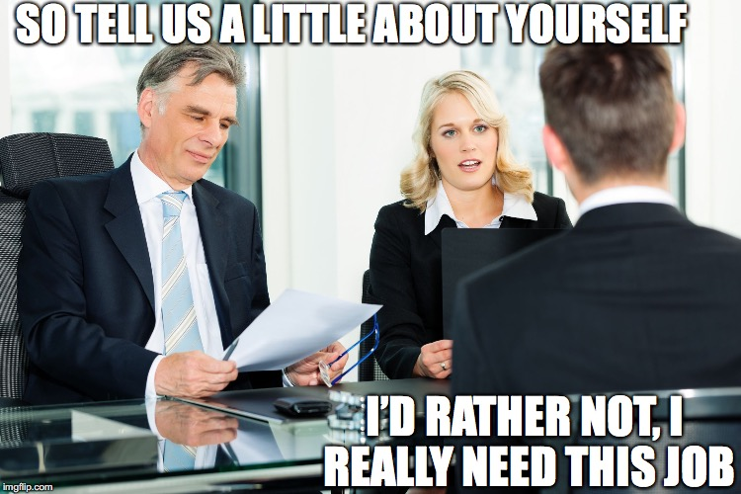
What Makes Up An Interview?
Phone Screening
HR or Recruiter
Fact Checking
Technical Interview
Virtual
In Person
Behavioral Interview
Second Interview/Follow-up
Notes:
LaunchCode has done the legwork, may not have phone screening

Slide 8

Interview Preparedness Tips
Know The Company
Mission Statements, Blogs, Social Media, Press Releases, Company Photos
Bring a Notebook, Pen, and Resumes
~15 Minutes Early
Take Them Up on the Water
Dress The Part

Slide 9

Arm Yourself
Have a Story to Tell
Be Proud of Your Past Work
Highlight Related Skills
Think About Your
Long Term Goals
Accomplishments
Challenges
Take Your Time
Have Questions in Mind
Take Notes for Later
Have a Closing Statement

Slide 10

Example Questions
With the recent x, how do you feel that will impact your business?
How does your team manage projects?
If agile has been mentioned, ask them how the use it
What sort of learning opportunities/reimbursement do you have?
Who will I be reporting to? Who makes up the leadership team?
Can I meet the team and see the workspace?
What are my work expectations and responsibilities? i.e. Core hours, on-call support, etc
What is your business model?
Where do you see the company heading?
When might you make a decision by?
Notes:
Tuition, Reimbursements, Conferences, etc
Tangible benes will be spelled out in the contract

Slide 11
Technical Interview Continued

Slide 12
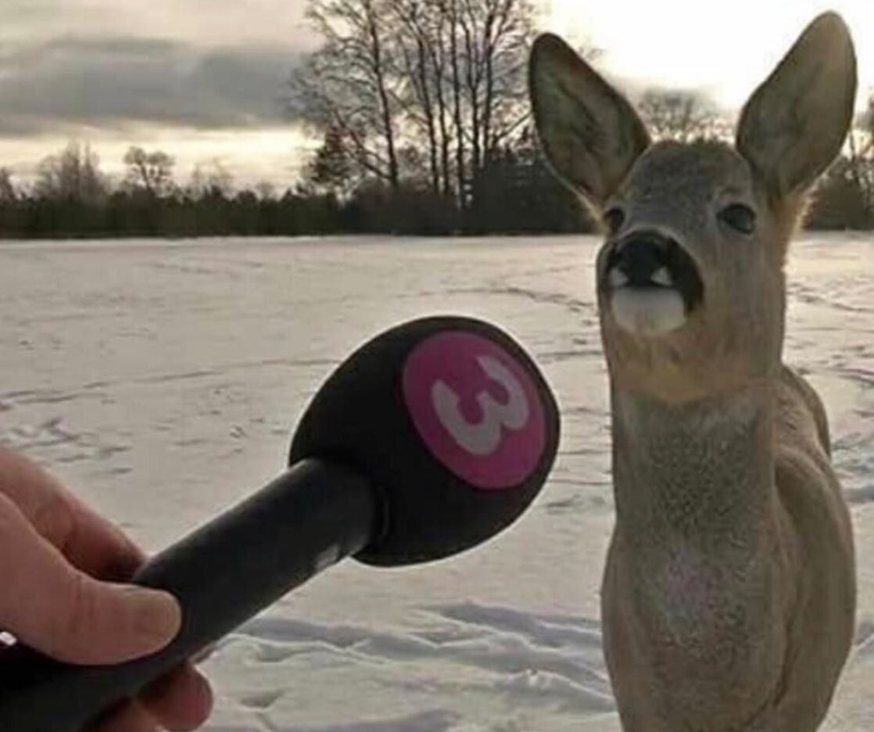
Technical Interview
Know The Tech Stack
Even If You Don’t Know It
Review Your Fundamentals
Object Oriented Programming Concepts
SOLID Design Principles
Language Terminology
Discuss Alternatives or Pros/Cons
You Will Be Assessed (Tested)
Be Prepared to Talk Tech about Your Projects or Contributions
Notes:
Fundamentals - Review early launchcode lessons, and then read more!

Slide 13
Behavioral Interview

Slide 14

Behavioral Interview
“Describe a Time…” questions
Focus on the Positives and Resolutions
Draw on Non-Work Experiences
Prepare by Identifying Accomplishments & Challenges
Looking for
Team Player
Problem Solver
Resolve Conflicts
Time Management

Slide 15

Claim Evidence Model
Claim - One or Two Sentence Answer
Gets to the Answer
Evidence - Provide Scenario as Evidence
Proves the Answer
Also known as the STAR (Situation, Task
Action & Result
Notes:
Mostly behavioral, but also technical

Slide 16

Behavioral Interviews - Next Week
Paired with Interviewer
Mostly Behavioral
Be Prepared to About Your Project
Assignment
Assess Placement Readiness

Slide 17
Q&A

Slide 18
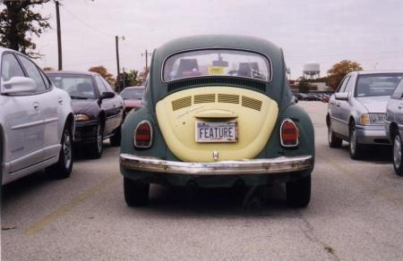
Exercise - Scrum
What you’ve finished
What you’re working on next
Any blockers

Slide 19
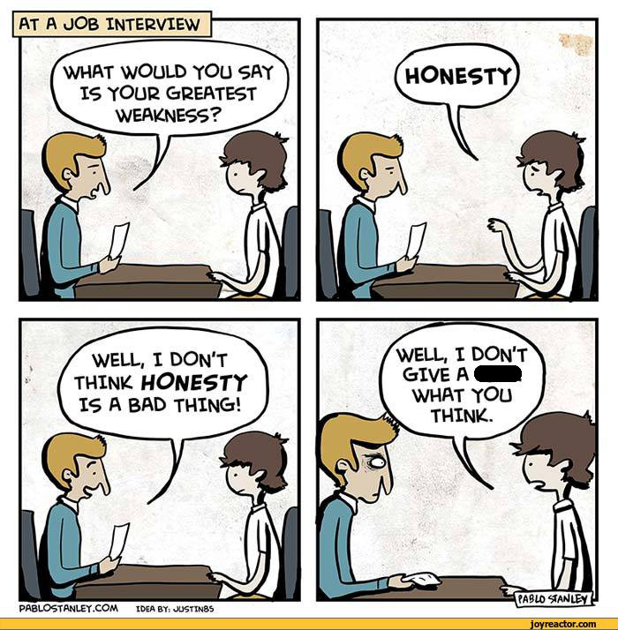
Exercise - Practice Interviews
Pair Up
Take turns “interviewing”
Ask 3 behavioral questions
Switch

